Slide 1

Introduction: memory representation, allocation and garbage collection.
Operations: Traversal, insertion and deletion.

Slide 2

Introduction
A linked list (One-way list) is a linear collection of data elements, called nodes, where the linear order is given by means of pointers.
Each node is divided into two parts.
First part contains the information of the element.
Second part contains the address of the next node in the list.

Slide 3
Linked List
A singly linked list is a concrete data structure consisting of a sequence of nodes
Each node stores
  element
  link to the next node
next
element
node
∅
A
B
C
D

Slide 4
Key Points
Linked list
  Linear collection of self-referential class objects, called nodes
  Connected by pointer links
  Accessed via a pointer to the first node of the list
  Link pointer in the last node is set to null to mark the list’s end
  Linked list contains a Pointer Variable called START, which contains the address of the first node.

Slide 5
Self-Referential Structures
Self-referential structures
  Structure that contains a pointer to a structure of the same type
  Can be linked together to form useful data structures such as lists, queues, stacks and trees
  Terminated with a NULL pointer (0)
Diagram of two self-referential structure objects linked together
  struct node {
  int info;
  struct node *link;
  };
link
  Points to an object of type node
  Referred to as a link of one node to next node.
3
2
100
…
500
Data member and pointer
NULL pointer (points to nothing)

Slide 6
Linked Representation of Data
358
797
561
501
In a linked representation, data is not stored in a contiguous manner. Instead, data is stored at random locations and the current data location provides the information regarding the location of the next data.
  Adding item 498 on to the linked list
  Q: What is the cost of adding an item?
  Q: how about adding 300 and 800
  onto the linked list
  Deleting item 358 from the linked list
  Q: What is the cost of deleting an item?
  Q: What is the cost of searching for an item?
345
724
555
490
701
513
358
797
561
501
345
724
555
490
701
513
498
358
797
561
501
345
724
555
490
701
513
498

Slide 7
Linked List
How do we represent a linked list in the memory
  Each location has two fields: Data Field and Pointer (Link) Field.
Linked List Implementation
struct node {
  int data;
  struct node *link;
  };
  struct node my_node;
  Example:
START
Node Element
Data Field
Pointer (Link) Field
Null Pointer
1
300
5
2
500
0
NULL
3
3
100
4
4
200
1
5
400
2

Slide 8
Why Linked List?
Arrays: pluses and minuses
+ Fast element access.
-- Expensive insertion deletion
-- Impossible to resize.
Need of Linked List
Many applications require resizing!
Required size not always immediately available.

Slide 9
Use a linked list instead of an array when
  You have an unpredictable number of data elements
  You want to insert and delete quickly.
  Features of Linked List
Lists are a particularly flexible structure because they can grow and shrink on demand, and elements can be accessed, inserted, or deleted at any position within a list.
Lists can also be concatenated together or split into sublists.
Lists arise routinely in applications such as information retrieval, programming language translation, and simulation.

Slide 10
Memory Representation
Linked lists are maintained in memory using linear arrays or Parallel arrays.
INFO LINK Start 1
2
3
4
5
6
7
8
9
10
2
A
E
C
B
D
F
6
9
7
4
3
0

Slide 11
Memory Representation (2)
Multiple lists in memory
INFO LINK
Start1 1
2
3
Start 2 4
5
6
7
8
9
10
2
S4
A
E
C
S2
B
D
S3
F
S1
0
6
9
7
8
4
3
1
0
5
10

Slide 12
Memory Representation (3)
INFO part of a node may be a record with multiple data items.
Records in memory using Linked lists
Start Name Age Sex LINK
1
2
3
4
5
6
7
8
9
10
2
A
E
C
B
D
F
19
21
20
19
22
20
M
M
F
F
M
F
6
9
7
4
3
0

Slide 13
Types of Linked Lists
  1. Singly linked list
    Begins with a pointer to the first node
    Terminates with a null pointer
    Only traversed in one direction
  2. Circular, singly linked
    Pointer in the last node points
    back to the first node
  3. Doubly linked list
    Two “start pointers” – first element and last element
    Each node has a forward pointer and a backward pointer
    Allows traversals both forwards and backwards
  4. Circular, doubly linked list
    Forward pointer of the last node points to the first node and backward pointer of the first node points to the last node

Slide 14
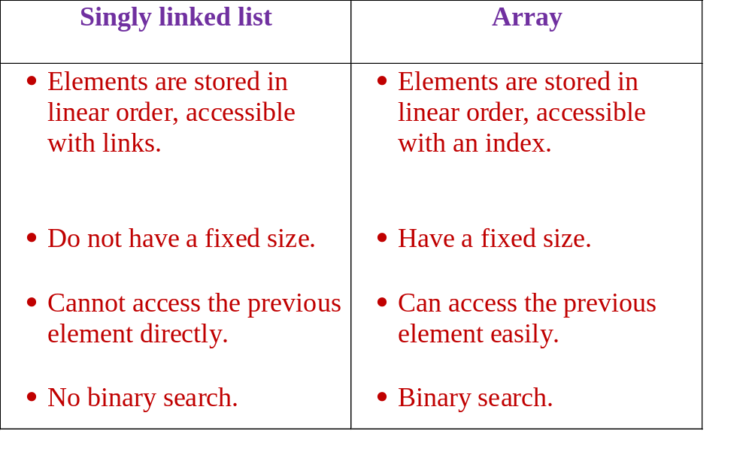
Difference between Singly Linked List and Arrays
Ravi Kant Sahu, Asst. Professor @ Lovely Professional University, Punjab (India)

Slide 15

bat •
cat •
sat •
vat NULL

Slide 16
Traversal in Linked List
Is to process information in each nodes’ info part
We initially only knows the address of first node that’s to perform operations such as traversal ,searching , insertion at middle, deletion at middle. We have to traverse the linked list sequentially.
We will use while loop to perform traversal
  Initialisation ptr=start
  Condition while ptr!= null
  Increment ptr=link[ptr]

Slide 17
Algorithm Traversal In linked list
Traversal(INFO,LINK,PTR,START): It is to traverse the linked list .
Set PTR := START [Initializes pointer Ptr]
Repeat step 3 and 4 while PTR != NULL [Condition]
Apply Process to INFO[PTR]
Set PTR := LINK[PTR] [Ptr now points to next node]
[End of step 2 loop]
5. Exit

Slide 18
Searching in linked list
As linked list is sequential data structure and initially we only know the address of first node only that’s why only linear search can be applied to linked list and not binary search.
to perform searching first traverse the linked list upto the point that
Info[PTR]=ITEM, if it found then break.

Slide 19
Algorithm of searching in unsorted linked list
Search(INFO,START,LINK,PTR,ITEM,LOC): ): It is to search ITEM the linked list where INFO representing the information part in each node, LINK is the link part holding the address of next node. PTR id pointer variable, START is pointer variable holding the address of first node. ITEM holds the value to search. LOC hold address of node found location
Set PTR := START [Initializes pointer Ptr]
Repeat step 3 while PTR!= NULL
If ITEM = INFO[PTR], then:
Set LOC := PTR and Exit
Else
Set PTR := LINK[PTR] [Ptr now points to next node]
[End of If structure]
[End of step 2 loop]
[Search is unsuccessful] Set LOC := NULL
Exit

Slide 20
Algorithm of searching in sorted linked list
SEARCH (INFO, LINK, START, ITEM, LOC)
Set PTR: = START.
Repeat Step 3 While PTR ≠ NULL.
If ITEM > INFO [PTR], then:
Set PTR: = LINK [PTR]. [PTR points to next node]
Else if ITEM = INFO [PTR], then:
Set LOC: = PTR, and EXIT. [Search is successful.]
Else:
Set LOC := NULL, and EXIT . [ITEM exceeds INFO[PTR]…]
[End of if Structure.]
[End of step 2 Loop.]
Return LOC .
Exit.

Slide 21
Memory Allocation
Together with the linked list, a special list is maintained which consists of unused memory cells.
This list has its own pointer.
This list is called List of available space or Free-storage list or Free pool.

Slide 22
Free Pool
Linked list with free pool or list of Available space. Address of first free node is stored in avail pointer variable
INFO LINK
START 1
2
3
AVAIL 4
5
6
7
8
9
10
2
A
E
C
B
D
F
0
6
9
7
8
4
3
1
0
5
10

Slide 23
Garbage Collection
Garbage collection is a technique of collecting all the deleted spaces or unused spaces in memory.
The OS of a computer may periodically collect all the deleted space onto the free-storage list.
Garbage collection may take place when there is only some minimum amount of space or no space is left in free storage list.
Garbage collection is invisible to the programmer.

Slide 24
Garbage Collection Process
Garbage collection takes place in two steps.
The computer runs through all lists tagging those cells which are currently in use.
Then computer runs through the memory, collecting all the untagged spaces onto the free storage list.

Slide 25
Overflow and Underflow
Overflow: When a new data are to be inserted into a data structure but there is no available space i.e. the free storage list is empty.
Overflow occurs when AVAIL = NULL, and we want insert an element.
Overflow can be handled by printing the ‘OVERFLOW’ message and/or by adding space to the underlying data structure.

Slide 26
Overflow and Underflow
Underflow: When a data item is to be deleted from an empty data structure.
Underflow occurs when START = NULL, and we want to delete an element.
Underflow can be handled by printing the ‘UNDERFLOW’ message.

Slide 27
Insertion into a Linked List
New node N (which is to be inserted) will come from AVAIL list.
First node in the AVAIL list will be used for the new node N.
Types of insertion:
Insertion at the beginning
Insertion between two nodes
Insertion after given node.

Slide 28
Algorithmic syntax to perform 4 steps to insert node(NOT ALGO)
    1.Check availability of node in avail list
    If AVAIL= null ,then:
    Write: overflow
    2.If available then remove the node from avail list
    Set NEW:=AVAIL
    Set AVAIL:=LINK[AVAIL]
    3.Insert element to info part of that node
    Set INFO[NEW]=ITEM
    4.Link the node with linked list where i want to perform insertion
      Set LINK[NEW]:=START //when insert at the beginning
      Set START:=NEW
      OR
      Set LINK[NEW]=LINK[LOC]//when insert after some location LOC
      Set Link[LOC]=NEW

Slide 29
Checking the Available List
AVAIL
ITEM
Ø
Free-Storage List
NEW

Slide 30
Insertion at the beginning of Linked List
START
Ø
ITEM

Slide 31
(1) Insertion Algorithm (Beginning of the list)
INSFIRST (INFO, LINK, START, AVAIL, ITEM):to insert element at the beginning
[OVERFLOW?] If AVAIL = NULL, then:
Write: OVERFLOW, and Exit.
2. [Remove first node from AVAIL list]
Set NEW:= AVAIL and AVAIL:= LINK [AVAIL].
Set INFO [NEW] := ITEM. [Insert data to new node].
Set LINK [NEW]: = START. [New node points to the original first node].
Set START := NEW. [START points to the new node.]
EXIT.

Slide 32
Insertion after a given node
START
Ø
ITEM

Slide 33
(2) Insertion Algorithm (After a given node)
INSLOC (INFO, LINK, START, AVAIL, LOC, ITEM): LOC is location of node after which we want to insert new node
[OVERFLOW?] If AVAIL = NULL, then: Write: OVERFLOW, and Exit.
[Remove first node from AVAIL list]
Set NEW:= AVAIL and AVAIL:= LINK [AVAIL].
Set INFO [NEW] := ITEM. [Copy the new data to the node].
If LOC = NULL, then: [Insert as a first node]
Set LINK [NEW] := START and START := NEW.
Else: [Insert after node with location LOC.]
Set LINK [NEW]: = LINK [LOC] and LINK [LOC]: = NEW.
[End of If structure.]
Exit.

Slide 34
(3)Algorithm to insert node in between two given nodes node
INSERT(DATA, LINK, START, A, B, N):Let START be a pointer to a linked list in memory with successive nodes A and B. Write an algorithm to insert N between nodes A and B. Where A and B are address of nodes.
    Set PTR := START
    Repeat step 3 to 8 while PTR ≠ NULL
    If PTR = A, then:
    Set LINK[N]: = LINK[PTR] (or = B)
    Set LINK[PTR]: = N
    EXIT
    else
    Set PTR:=LINK[PTR]
    If PTR = NULL,then:
    Write: insertion unsuccessful.
    EXIT
START
1000
2000
Node A
Node B
3000
4000
5000
START
Node A
Node B
1000
2000
3000
4000
5000
3500
PTR
Node N

Slide 35
Insertion into a sorted Linked List
If ITEM is to be inserted into a sorted linked list. Then ITEM must be inserted between nodes A and B such that:
INFO [A] < ITEM < INFO [B]
First of all find the location of Node A
Then insert the node after Node A.
INSERT (INFO, LINK, START, AVAIL, ITEM)
CALL FIND_A (INFO, LINK, START, AVAIL, ITEM)
[USE Algorithm FIND_A to find the location of node preceding ITEM.]
CALL INSLOC (INFO, LINK, START, AVAIL, LOC, ITEM)
[Insert ITEM after a given node with location LOC.]
Exit.

Slide 36
FIND_A (INFO, LINK, START, ITEM, LOC)
[List Empty?] If START := NULL, then: Set LOC: = NULL, and Return.
[Special Case?] If ITEM < INFO [START], then: Set LOC := NULL, and Return.
Set SAVE: = START and PTR := LINK [START]. [Initializes pointers]
Repeat step 5 and 6 while PTR ≠ NULL.
If ITEM < INFO [PTR] then:
Set LOC: = SAVE, and Return.
[End of If Structure.]
Set SAVE: = PTR and PTR: = LINK [PTR]. [Update pointers]
[End of Step 4 Loop.]
Set LOC: = SAVE.
Return.

Slide 37
Deletion from a Linked List
A node N is to be deleted from the Linked List.
Node N is between node A and node B.
Deletion occurs as soon as the next pointer field of node A is changed so that it points to node B.
Types of Deletion:
Deleting the node following a given node
Deleting the Node with a given ITEM of Information.

Slide 38
Deletion from Linked List
START
ITEM
Ø
Node A
Node N
Node B

Slide 39
Maintaining the AVAIL List
After the deletion of a node from the list, memory space of node N will be added to the beginning of AVAIL List.
If LOC is the Location of deleted node N:
LINK [LOC] := AVAIL
AVAIL := LOC

Slide 40
Deleting the Node Following a given Node
DEL (INFO, LINK, START, AVAIL, LOC, LOCP)
If LOCP = NULL, then:
Set START := LINK [START]. [Delete First node.]
Else:
Set LINK [LOCP]: = LINK [LOC]. [Delete node N.]
[End of If Structure.]
[Return Deleted node to the AVAIL list]
Set LINK [LOC] = AVAIL and AVAIL= LOC.
EXIT.

Slide 41
Deleting the Node with a given ITEM of Information
DELETE (INFO, LINK, START, AVAIL, ITEM)
Call FIND_B (INFO, LINK, START, ITEM, LOC, LOCP)
[Find the Location of node N and its preceding node]
If LOC = NULL, then: Write: ITEM not in LIST and EXIT.
[Delete node].
If LOCP = NULL, then:
Set START: = LINK [START]. [Delete First node]
Else:
Set LINK [LOCP]: = LINK [LOC].
[End of If Structure.]
[Return Deleted node to the AVAIL list]
Set LINK [LOC] := AVAIL and AVAIL:= LOC.
5. EXIT.

Slide 42
FIND_B (INFO, LINK, START, ITEM, LOC, LOCP)
[List Empty?] If START = NULL, then:
Set LOC := NULL, LOCP := NULL and Return.
[End of If Structure.]
[ITEM in First node?] If INFO [START] = ITEM, then:
Set LOC := START, and LOCP := NULL, and Return.
[End of If Structure.]
Set SAVE := START and PTR: = LINK [START]. [Initializes pointers]
Repeat step 5 and 6 while PTR ≠ NULL.
If INFO [PTR] = ITEM, then:
Set LOC: = PTR and LOCP: = SAVE, and Return.
[End of If Structure.]
Set SAVE := PTR and PTR: = LINK [PTR]. [Update pointers]
[End of Step 4 Loop.]
Set LOC := NULL. [Search Unsuccessful.]
Return.

Slide 43
Plus and Minus of linked list of linked list
++No running out of memory, no wastage of memory.
++Insertion and deletion is easy, no physical movement.
--Traversal is difficult, we have to traverse (n-1) elements to go to the nth element.
--Wastage of memory in each element for storing the address of the next element.

Slide 44
Thank You

